Slide 1
MPC: Final presentation

Slide 2
AGENDA
Intro, Model Dynamics & MPC Formulation
Nonlinear Optimization & Obstacle Constraint
Reference Trajectory & Obstacle Generation
Parameter Analysis, Result & Outlook

Slide 3


Task

Slide 4
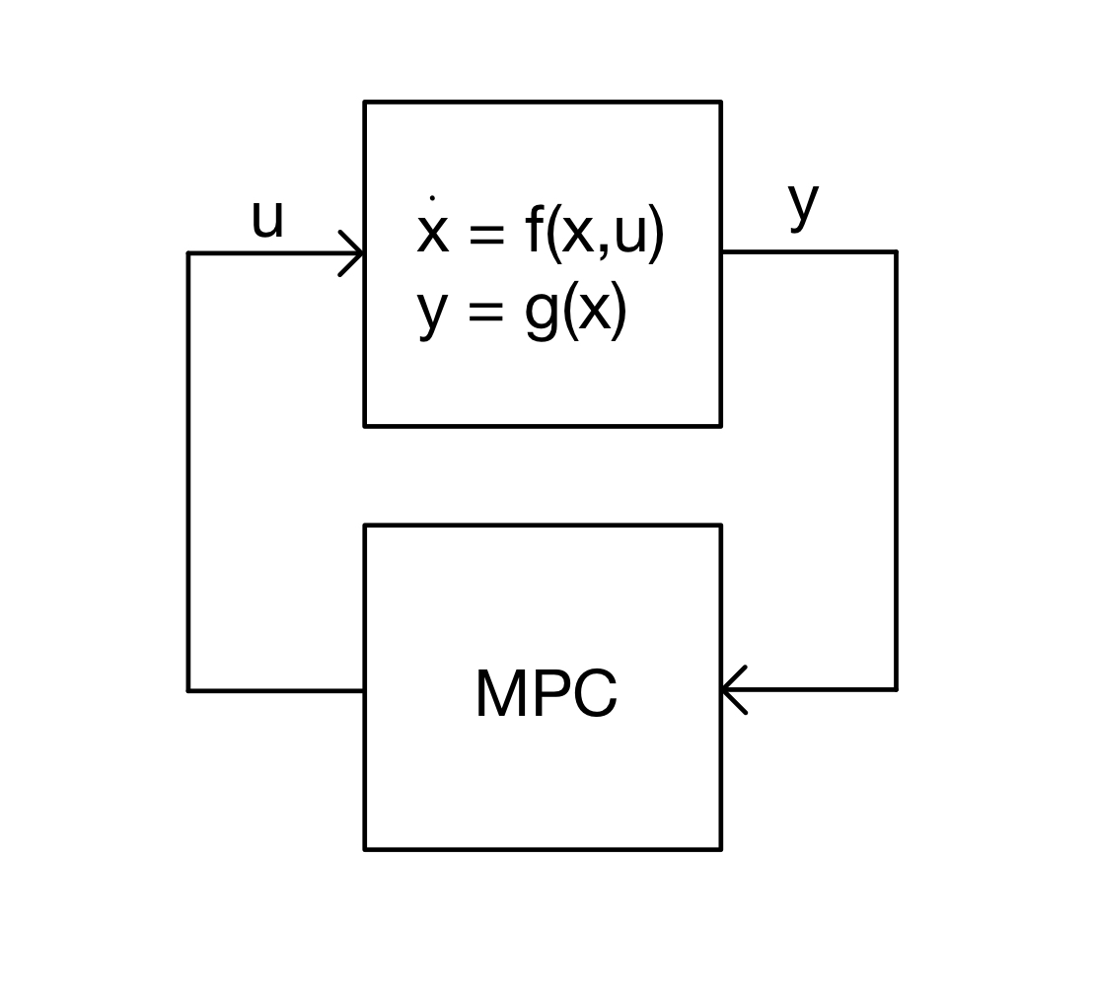
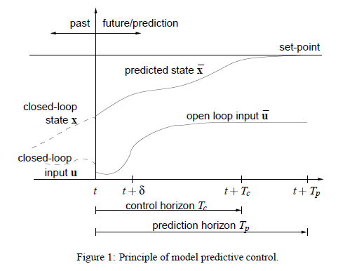
Principle of NMPC
An Introduction to Nonlinear Model Predictive Control

Slide 5

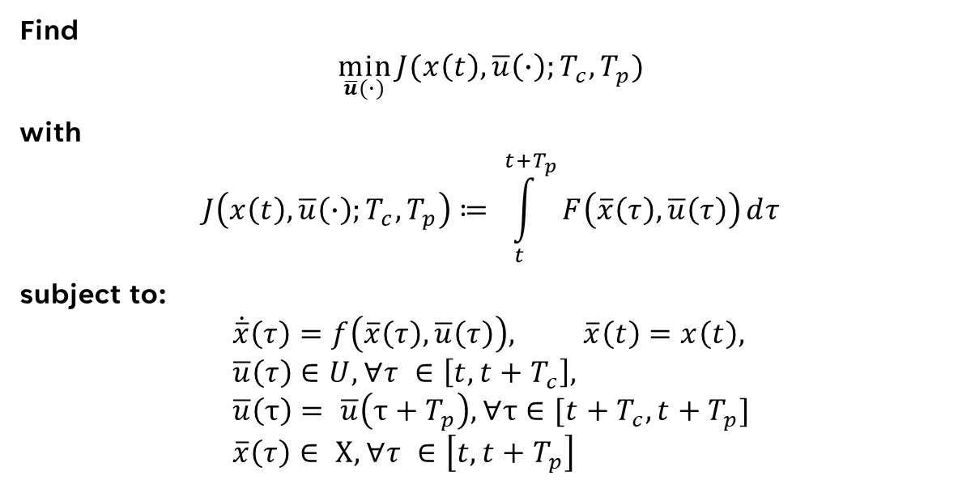
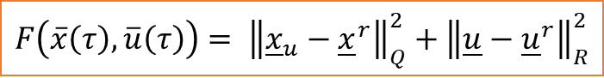
Mathematical Formulation of NMPC
$$\dot{x}\left(t\right)=f\left(x\left(t\right),u\left(t\right)\right), x\left(0\right)= x_{0} \\ u\left(t\right)∈U,∀t≥0 \\ x\left(t\right)∈X,∀t≥0$$
Find
$$\min_{\overline{u}(∙)}{J(x\left(t\right), \overline{u}\left(∙\right);{T_{c},T}_{p})}$$
with
$$J\left(x\left(t\right),\overline{u}\left(∙\right);T_{c},T_{p}\right)≔ \int_{t}^{t+T_{p}}{F\left(\overline{x}\left(τ\right),\overline{u}\left(τ\right)\right)ⅆτ}$$
subject to:
$$\dot{\overline{x}}\left(τ\right)=f\left(\overline{x}\left(τ\right), \overline{u}\left(τ\right)\right), \overline{x}\left(t\right)=x\left(t\right), \\ \overline{u}\left(τ\right)∈U, ∀τ ∈\left[t, t+T_{c}\right], \\ \overline{u}\left(τ\right)= \overline{u}\left(τ+T_{p}\right),∀τ∈[t+T_{c},t+T_{p}] \\ \overline{x}\left(τ\right)∈ Χ, ∀τ ∈\left[t, t+T_{p}\right]$$
$$F\left(\overline{x}\left(τ\right),\overline{u}\left(τ\right)\right)= {\left\|{\underline{x}}_{u}−{\underline{x}}^{r}\right\|}_{Q}^{2}+{\left\|\underline{u}−{\underline{u}}^{r}\right\|}_{R}^{2}$$

Slide 6
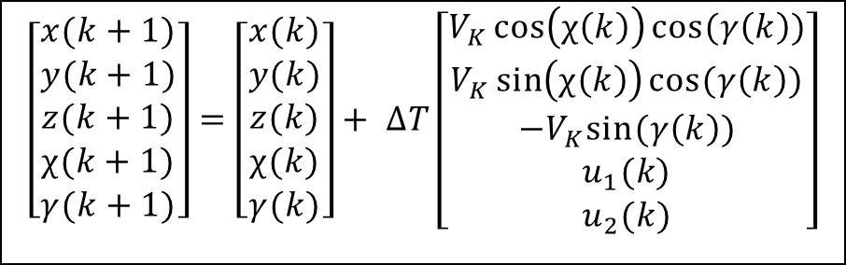
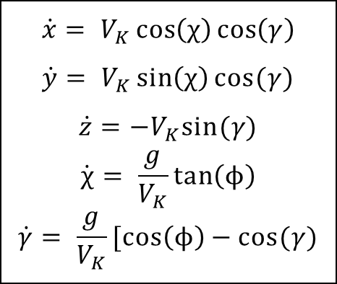
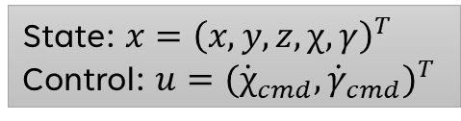
Dynamics and Kinematics
Model Dynamics
Euler Discretization
$$\dot{x}= V_{K}\cos\left(χ\right)\cos\left(γ\right)$$
$$\dot{y}= V_{K}\sin\left(χ\right)cos⁡(γ)$$
$$\dot{z}=−V_{K}sin⁡(γ)$$
$$\dot{χ}= \frac{g}{V_{K}}\tan\left(ϕ\right)$$
$$\dot{γ}= \frac{g}{V_{K}}[\cos\left(ϕ\right)−cos⁡(γ)$$
$$\left[\begin{matrix}x(k+1) \\ \begin{matrix}y(k+1) \\ z(k+1) \\ \begin{matrix}χ(k+1) \\ γ(k+1)\end{matrix}\end{matrix}\end{matrix}\right]=\left[\begin{matrix}x(k) \\ \begin{matrix}y(k) \\ z(k) \\ \begin{matrix}χ(k) \\ γ(k)\end{matrix}\end{matrix}\end{matrix}\right]+ ∆T\left[\begin{matrix}V_{K}\cos\left(χ\left(k\right)\right)cos⁡(γ\left(k\right)) \\ \begin{matrix}V_{K}\sin\left(χ\left(k\right)\right)cos⁡(γ\left(k\right)) \\ −V_{K}sin⁡(γ\left(k\right)) \\ \begin{matrix}u_{1}(k) \\ u_{2}(k)\end{matrix}\end{matrix}\end{matrix}\right]$$
State: $x={\left(x, y, z, χ, γ\right)}^{T}$
Control: $u={({\dot{χ}}_{cmd}, {\dot{γ}}_{cmd})}^{T}$

Slide 7
AGENDA
Intro, Model Dynamics & MPC Formulation
Nonlinear Optimization & Obstacle Constraint
Reference Trajectory & Obstacle Generation
Parameter Analysis, Result & Outlook

Slide 8
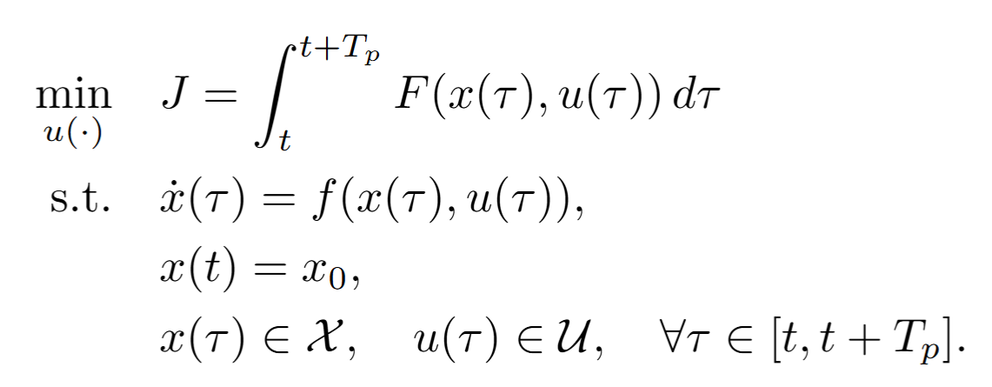
How we implemented the optimization
We started with the continuous time optimal control problem mentioned before:

Slide 9
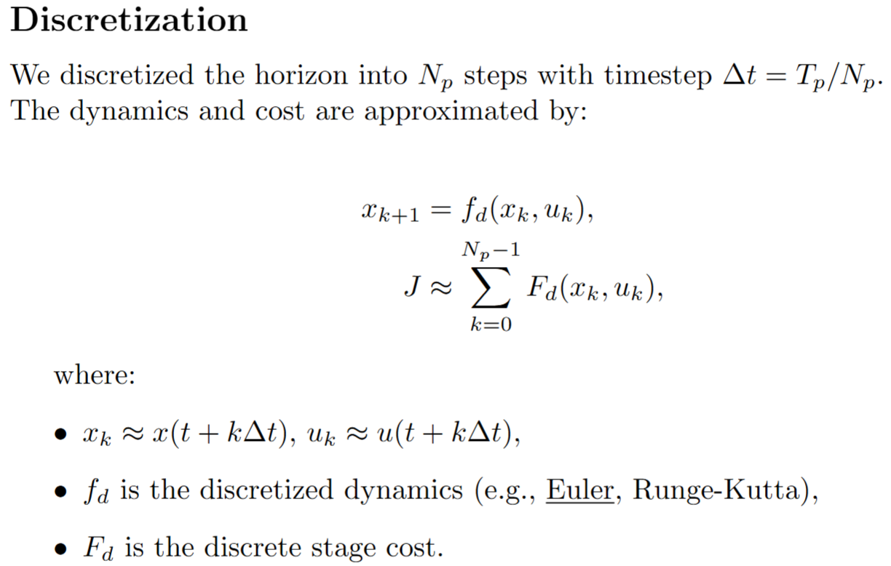
How we implemented the optimization

Slide 10
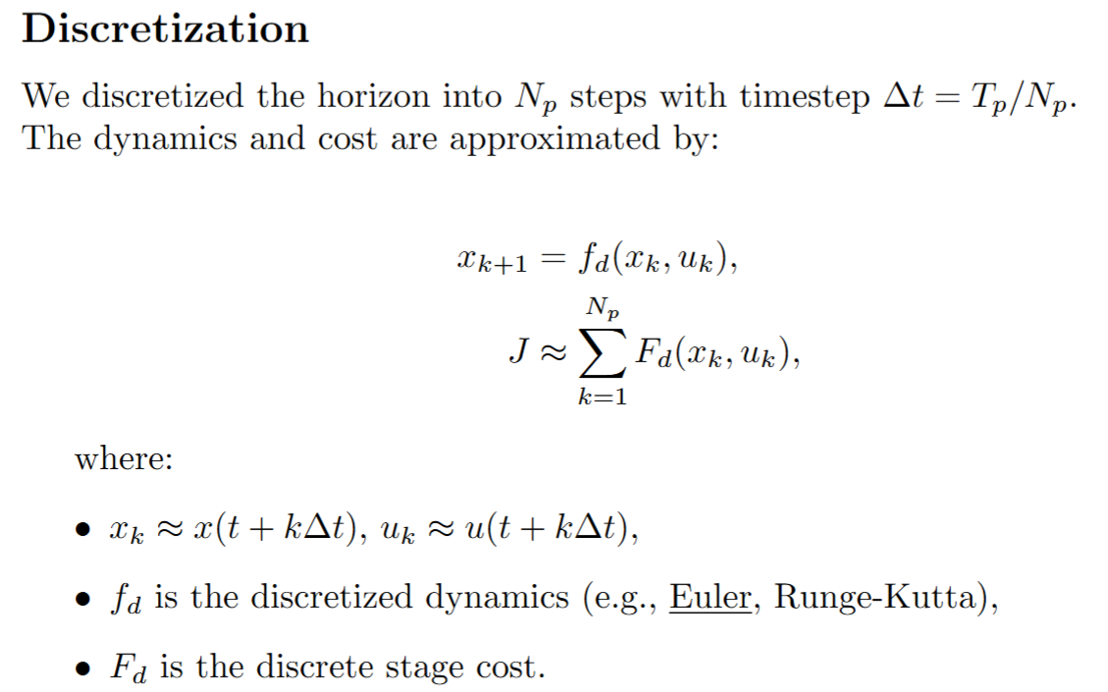
How we implemented the optimization

Slide 11
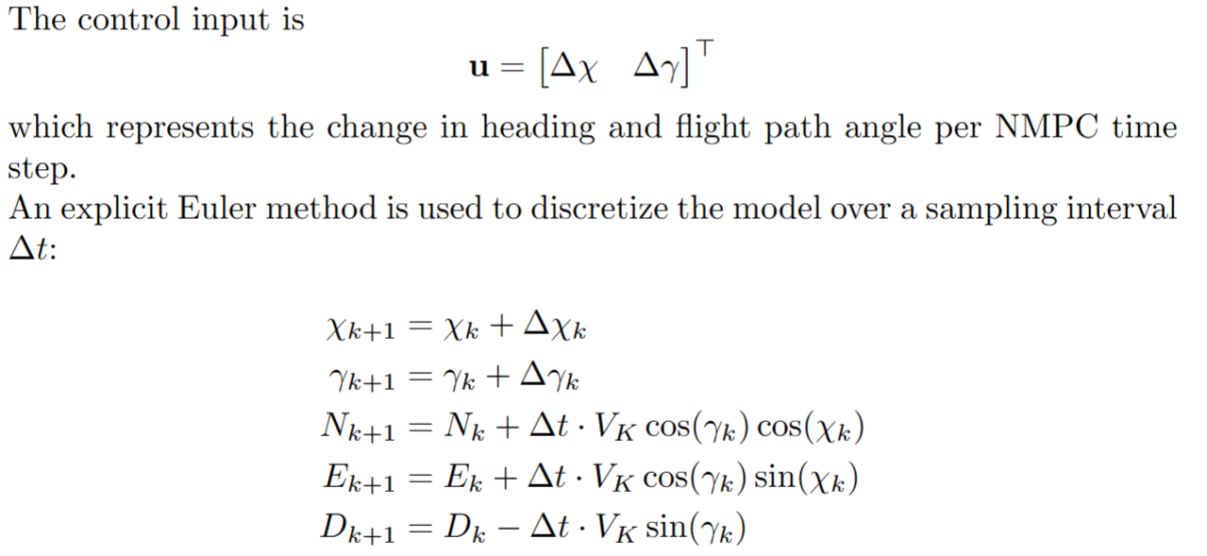
How we implemented the optimization

Slide 12
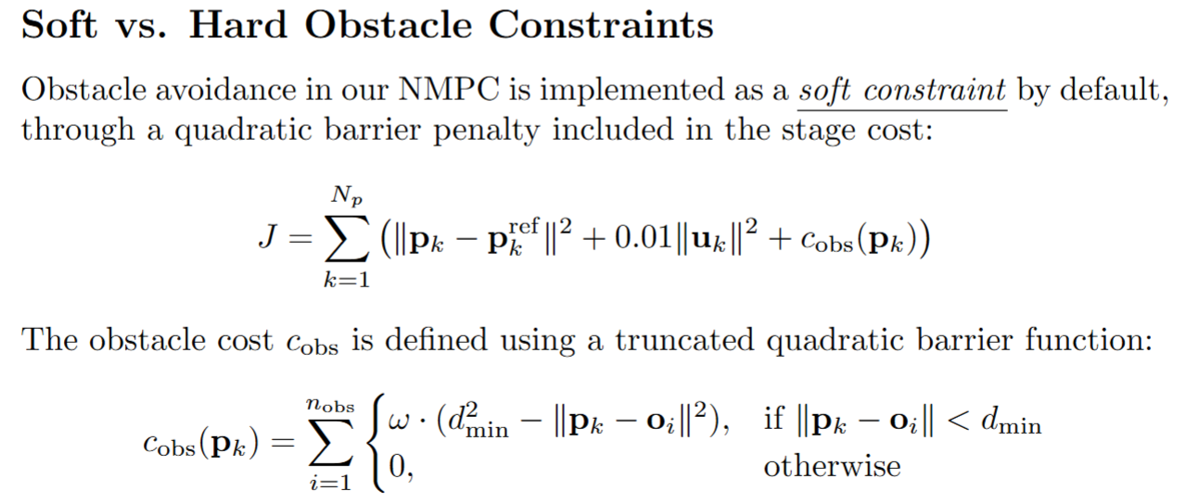
How we implemented the optimization
Alternatively for a cylinder the obstacle cost would be:
Notes:
Soft constraint does not guarantee obstacle avoidance, it just makes the cost really high and therefore ist more likely that other paths are less costly and therefore chosen.

Slide 13
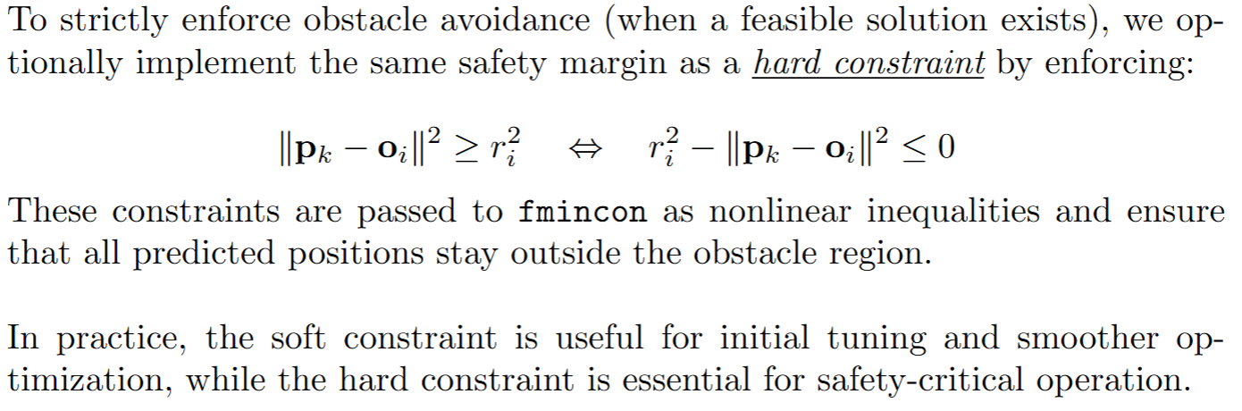
How we implemented the optimization
Notes:
Hard constraint in our implementation needed extra state integration calls which lead to runtime errors or infeasibility, which is why we use soft contraints in our demo.

Slide 14
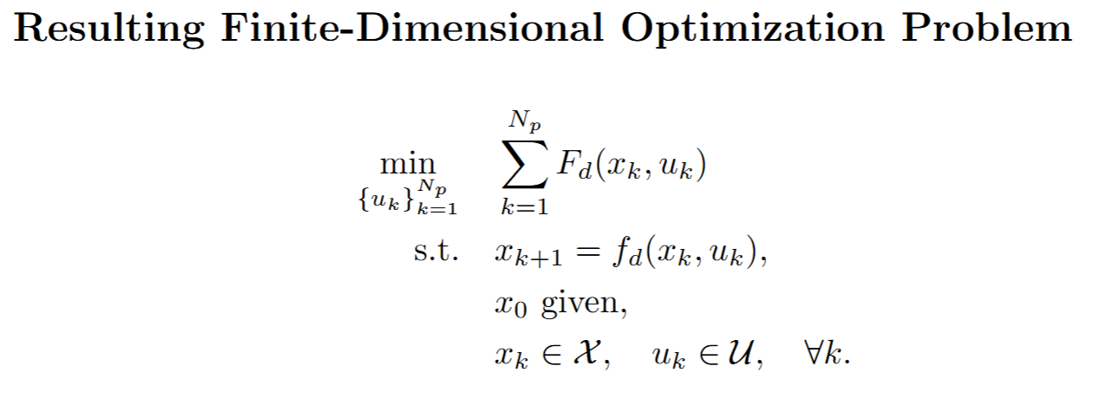
How we implemented the optimization

Slide 15
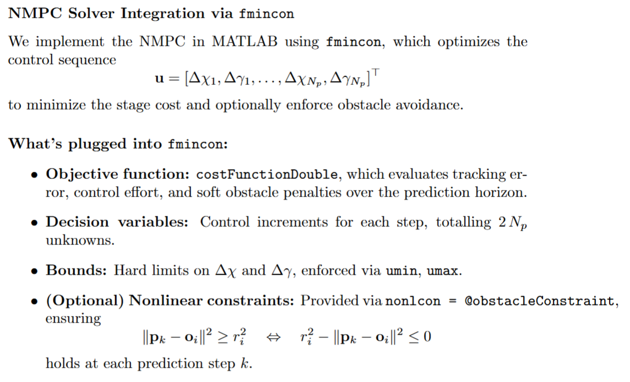
How we implemented the optimization

Slide 16
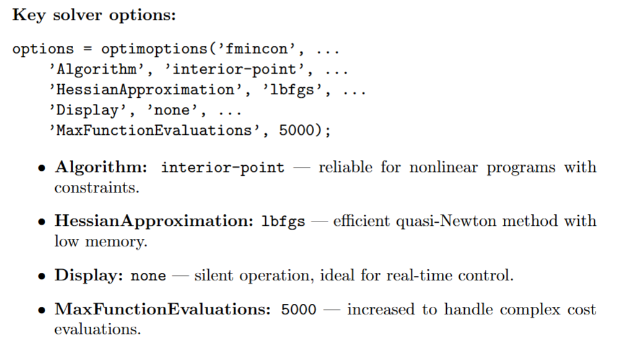
How we implemented the optimization

Slide 17
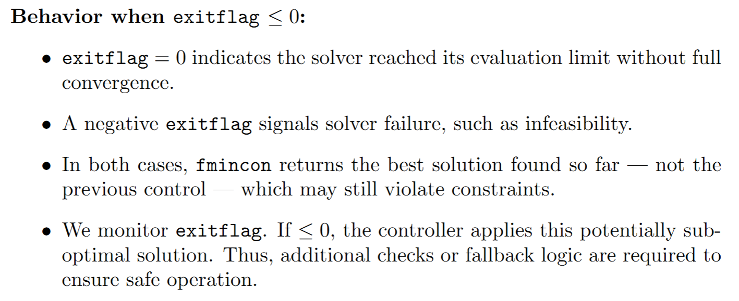
How we implemented the optimization

Slide 18
How we implemented the optimization

Slide 19
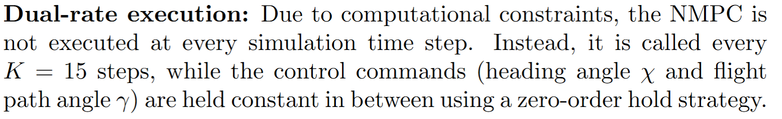
How we implemented the optimization

Slide 20
AGENDA
Intro, Model Dynamics & MPC Formulation
Nonlinear Optimization & Obstacle Constraint
Reference Trajectory & Obstacle Generation
Parameter Analysis, Result & Outlook

Slide 21
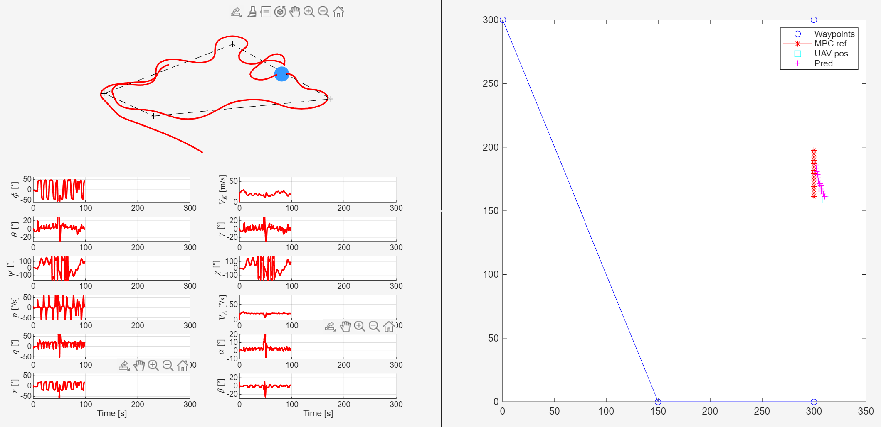
Reference Trajectory: Encountered challenges
Example shown
Reference Points spaced out equally to V_k*dt_mpc
Reference Trajectory starts at Position projected onto Path

Slide 22
Reference Trajectory: Encountered challenges
Aircraft oscillates around Path:
Intentions to hard- or soft-constrain Chi and Gamma in Model or Cost-Function did not yield the desired effect
MPC predicts Path that Aircraft can not follow
Obstacle Avoidance failed:
Short Prediction Horizon because of feasibility issues
Reference Trajectory short in comparison to Obstacle size

Slide 23
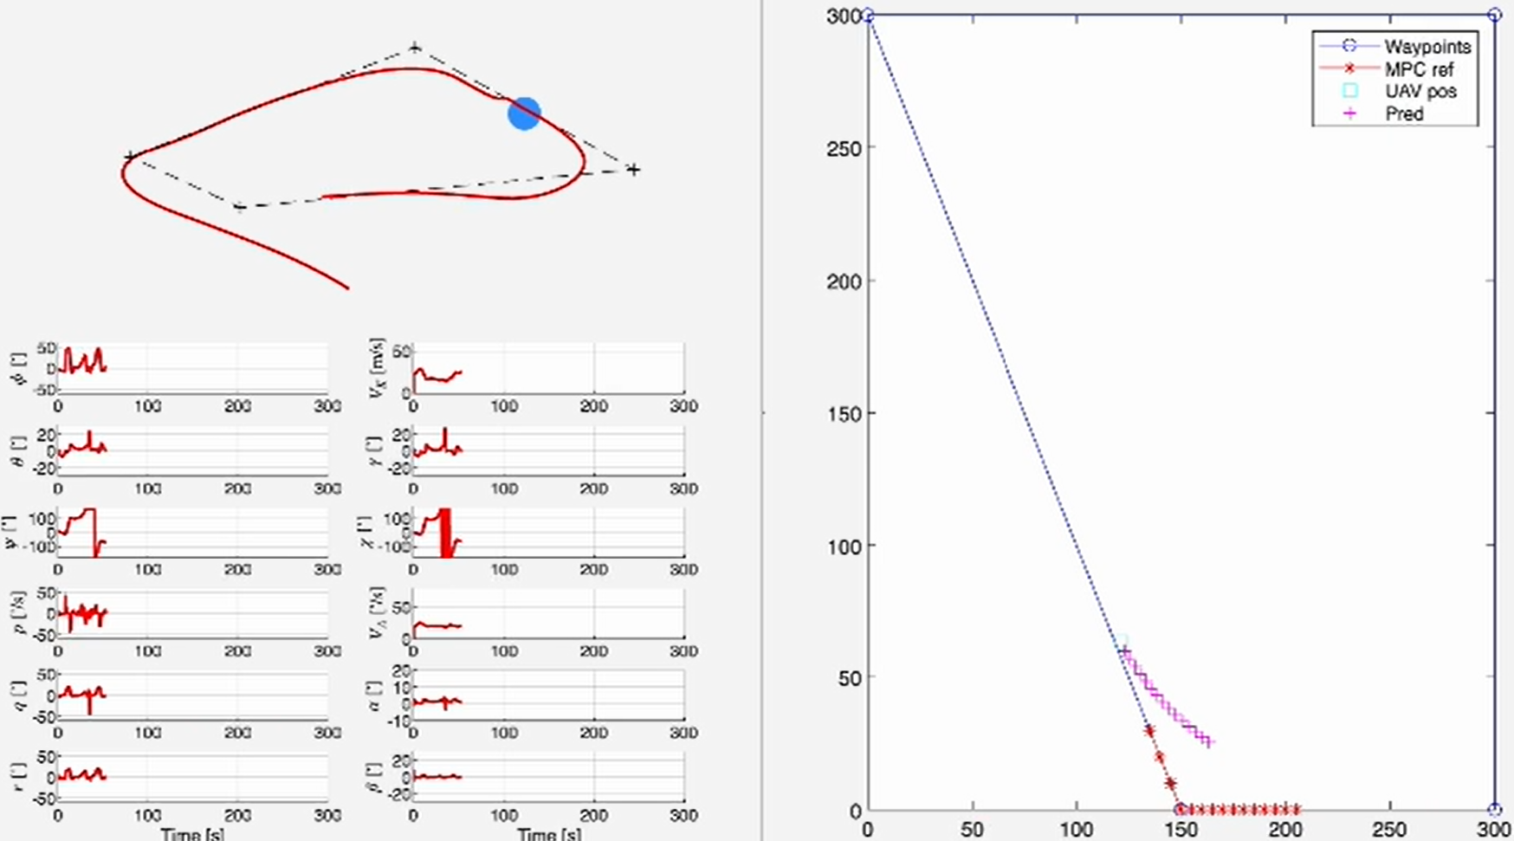
Reference Trajectory: Finally Implemented
Reference Points spaced farer apart from each other
Reference Trajectory starts farer away from Aircraft

Slide 24
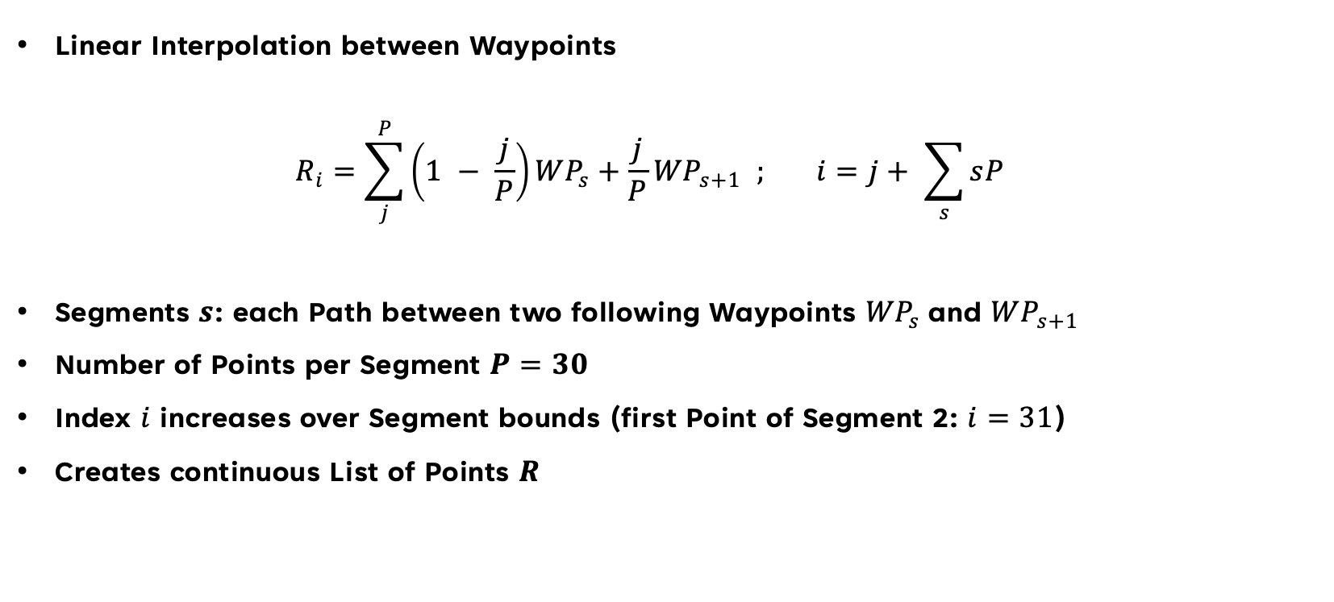
Reference Trajectory: Path Parameterization
Linear Interpolation between Waypoints
$$R_{i}=\sum_{j}^{P}{\left(1 − \frac{j}{P}\right){WP}_{s}+\frac{j}{P}}{WP}_{s+1} ; i=j+ \sum_{s}{sP}$$
Segments $s$: each Path between two following Waypoints ${WP}_{s}$and ${WP}_{s+1}$
Number of Points per Segment $P=30$
Index $i$ increases over Segment bounds (first Point of Segment 2: $i=31$)
Creates continuous List of Points $R$

Slide 25
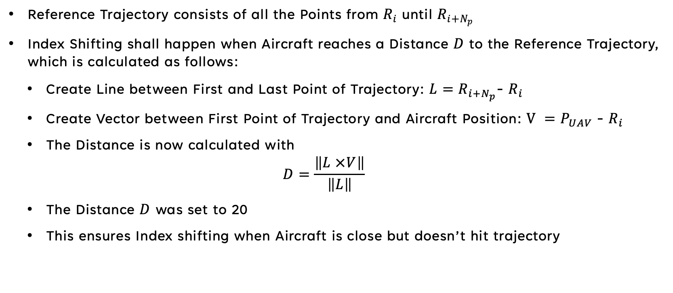
Reference Trajectory: Index shifting
Reference Trajectory consists of all the Points from $R_{i}$ until $R_{i+N_{p}}$
Index Shifting shall happen when Aircraft reaches a Distance $D$ to the Reference Trajectory, which is calculated as follows:
Create Line between First and Last Point of Trajectory: $L=R_{i+N_{p}}$- $R_{i}$
Create Vector between First Point of Trajectory and Aircraft Position: $V =P_{UAV}$- $R_{i}$
The Distance is now calculated with
$$D=\frac{\left\|L ×V\right\|}{\left\|L\right\|}$$
The Distance $D$ was set to 20
This ensures Index shifting when Aircraft is close but doesn’t hit trajectory

Slide 26
AGENDA
Intro, Model Dynamics & MPC Formulation
Nonlinear Optimization & Obstacle Constraint
Reference Trajectory & Obstacle Generation
Parameter Analysis, Result & Outlook

Slide 27
Parameter Analysis
Fine tuning prediction horizon = 15, reference points per segment = 30 , obstacle cost = 1000 & tolerance for index switching = 20m
Obstacle cost: High

Slide 28
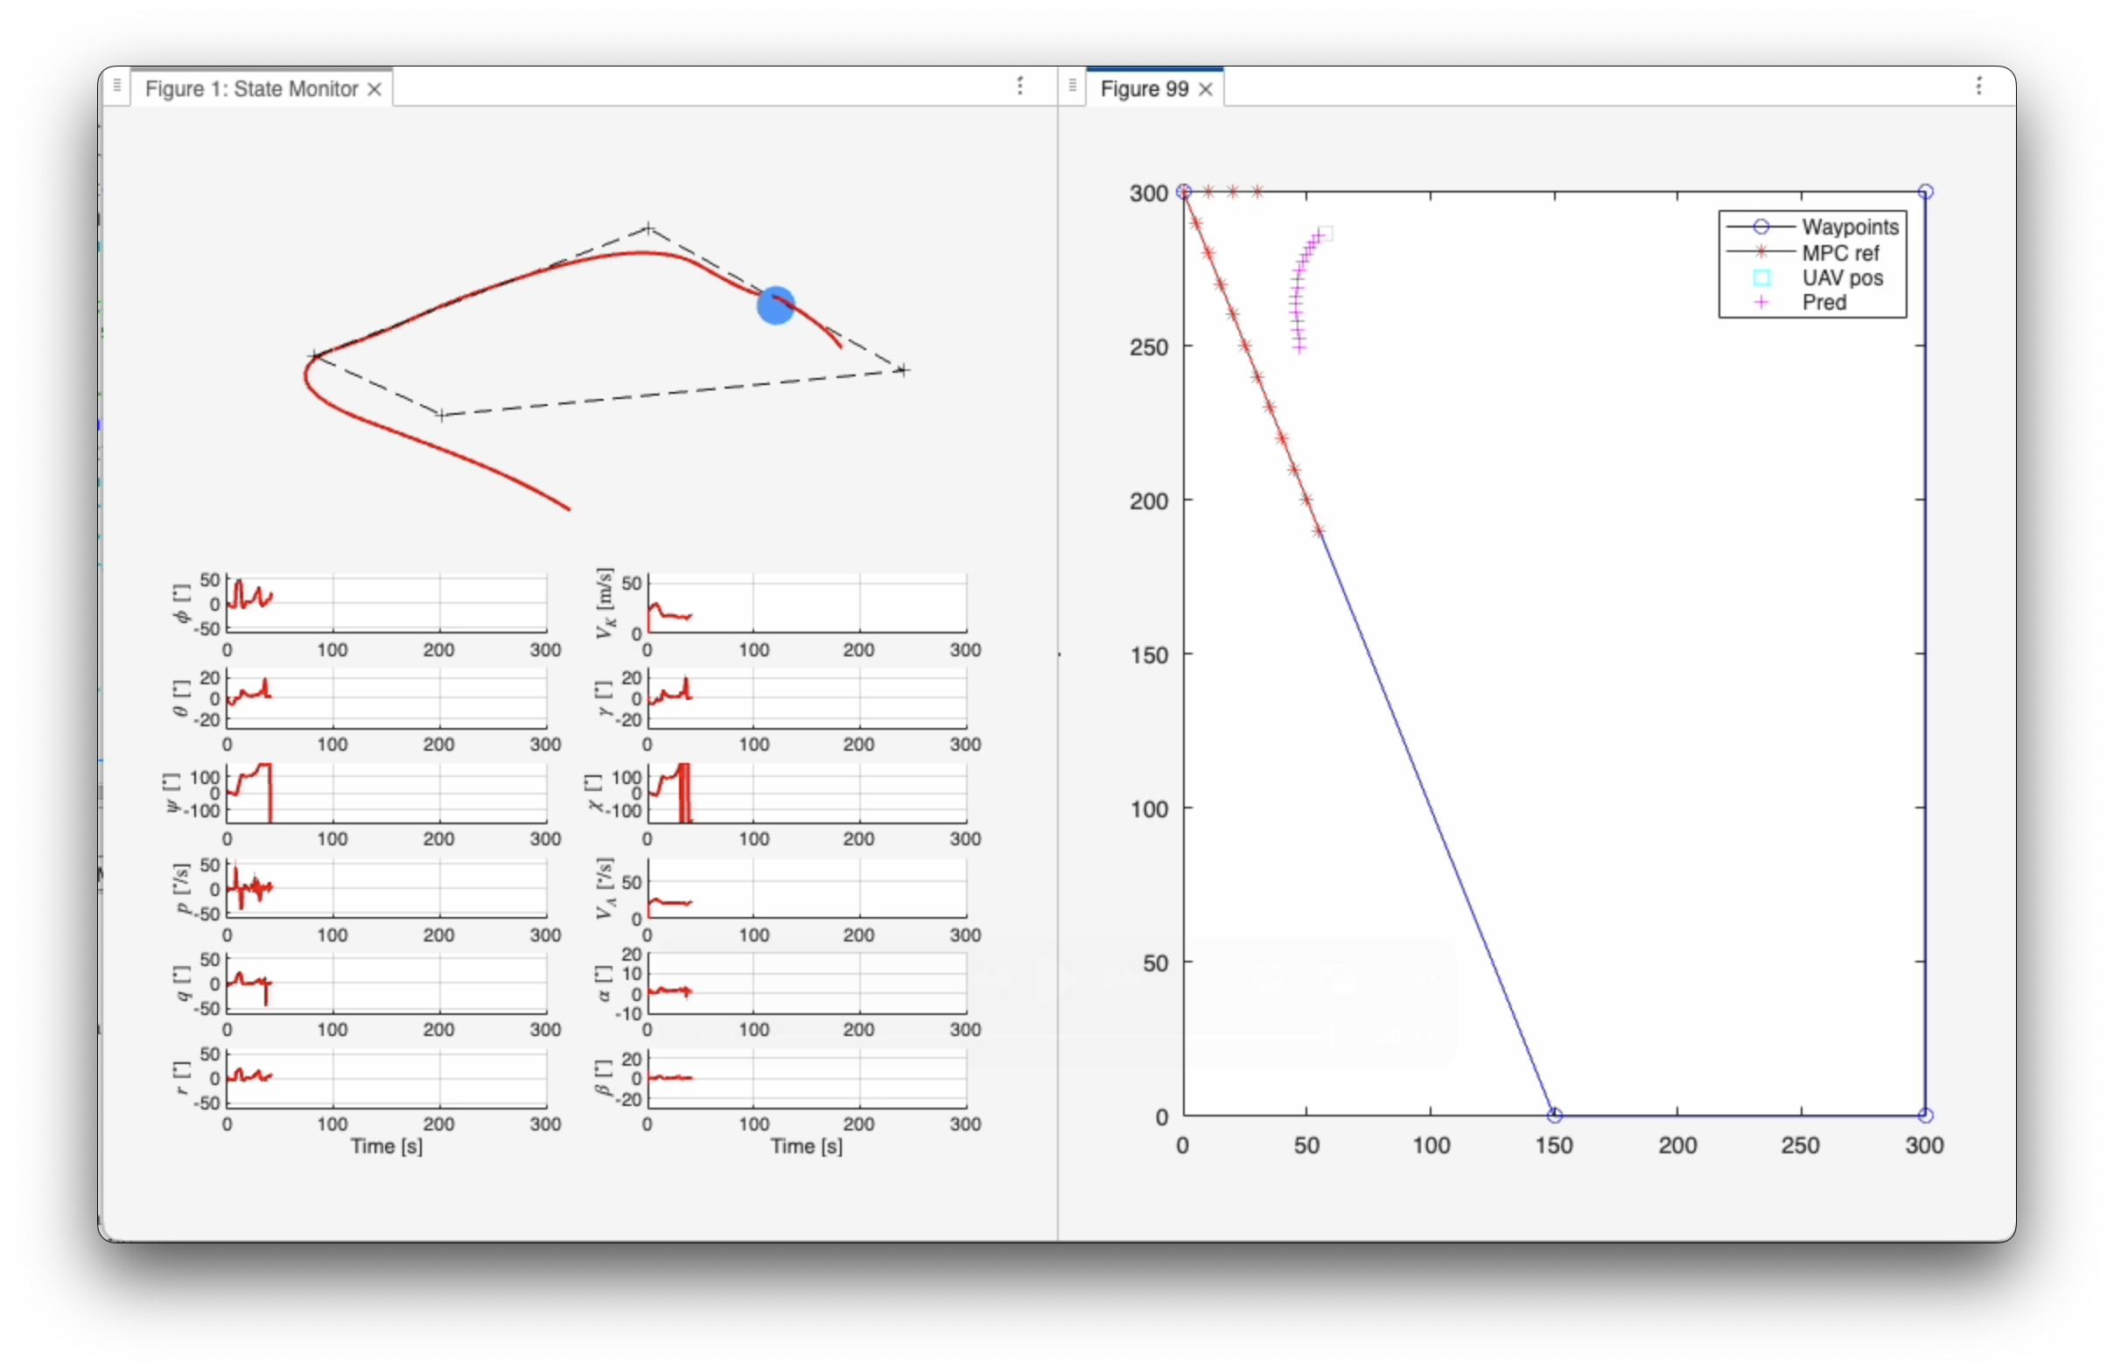
Obstacle Cost LoW

Slide 29
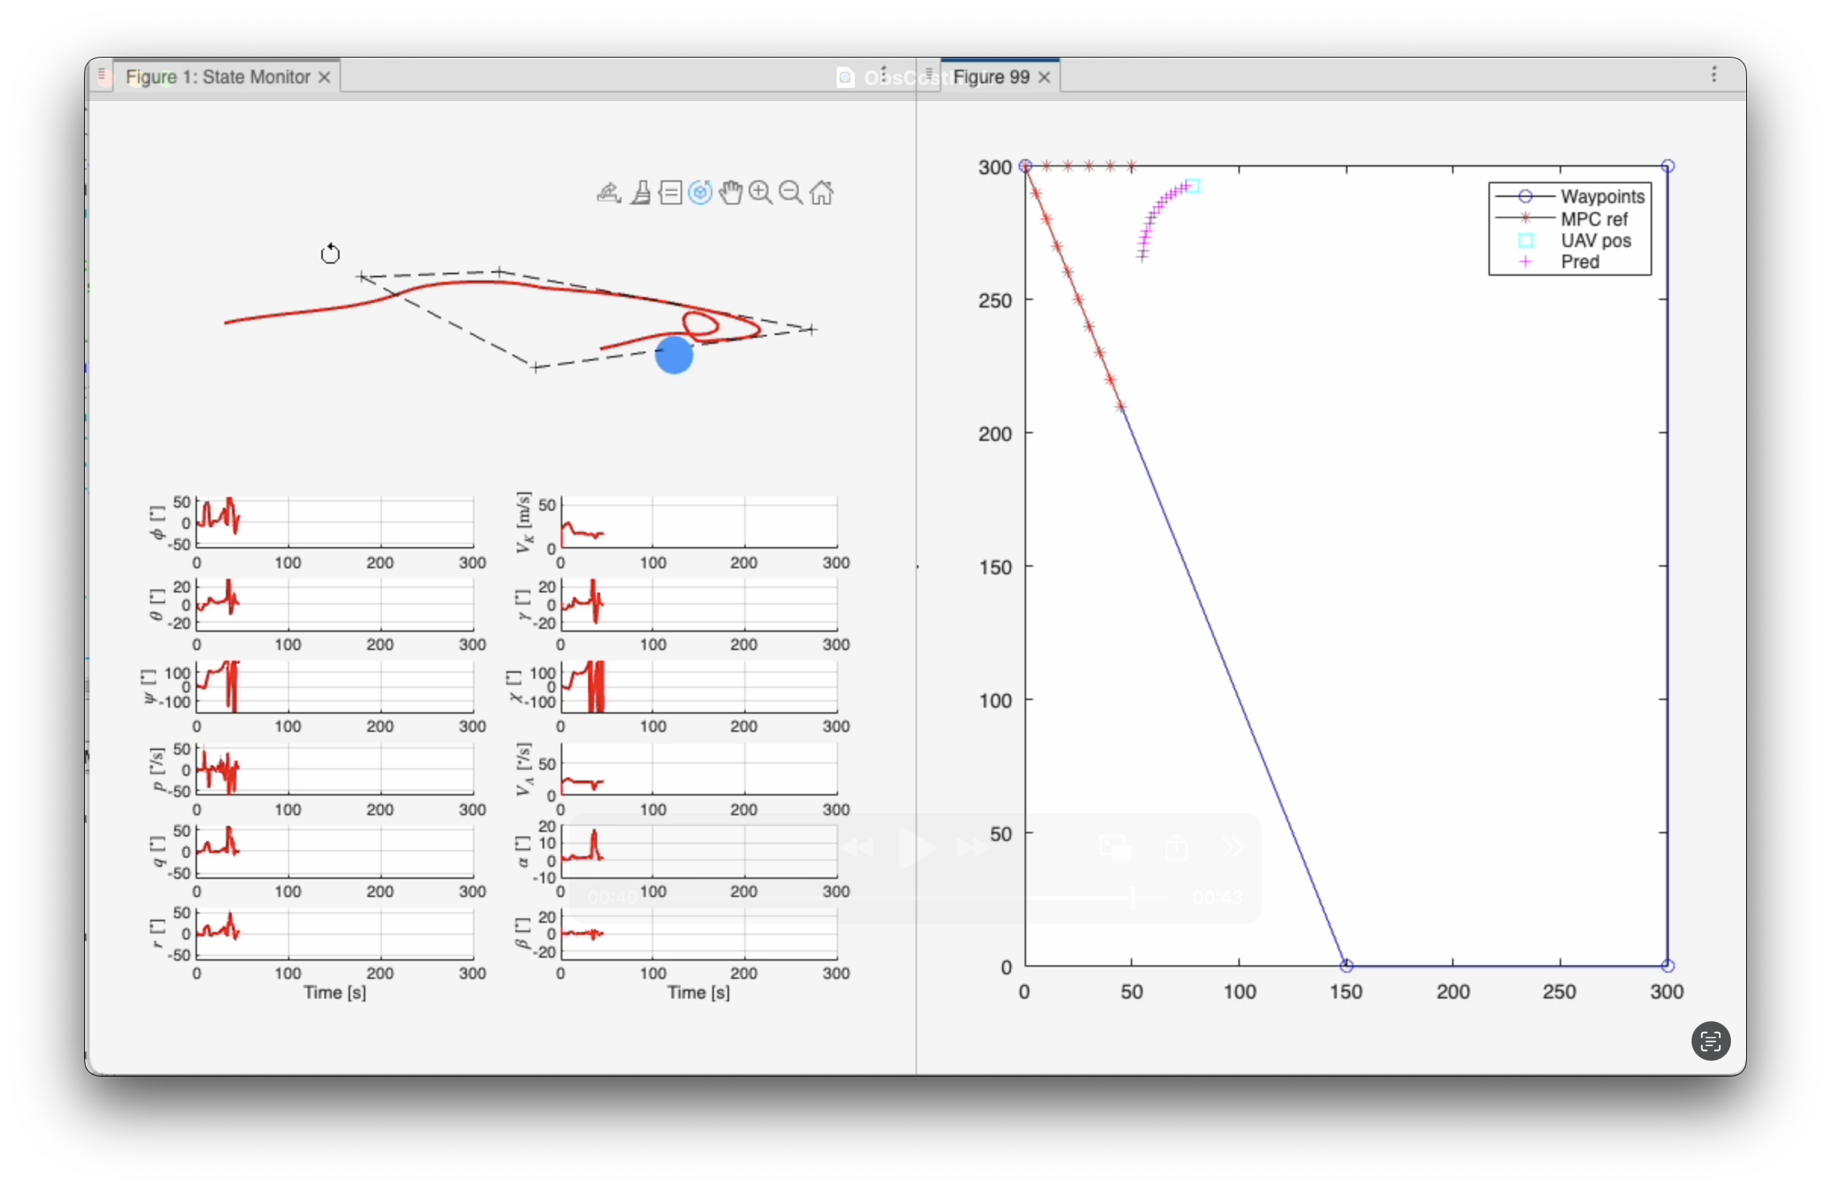
Obstacle cost High

Slide 30
Parameter Analysis
Fine tuning prediction horizon = 15, reference points per segment = 30 , obstacle cost = 1000 & tolerance for index switching = 20m
Obstacle cost:
Tolerance index switching:

Slide 31
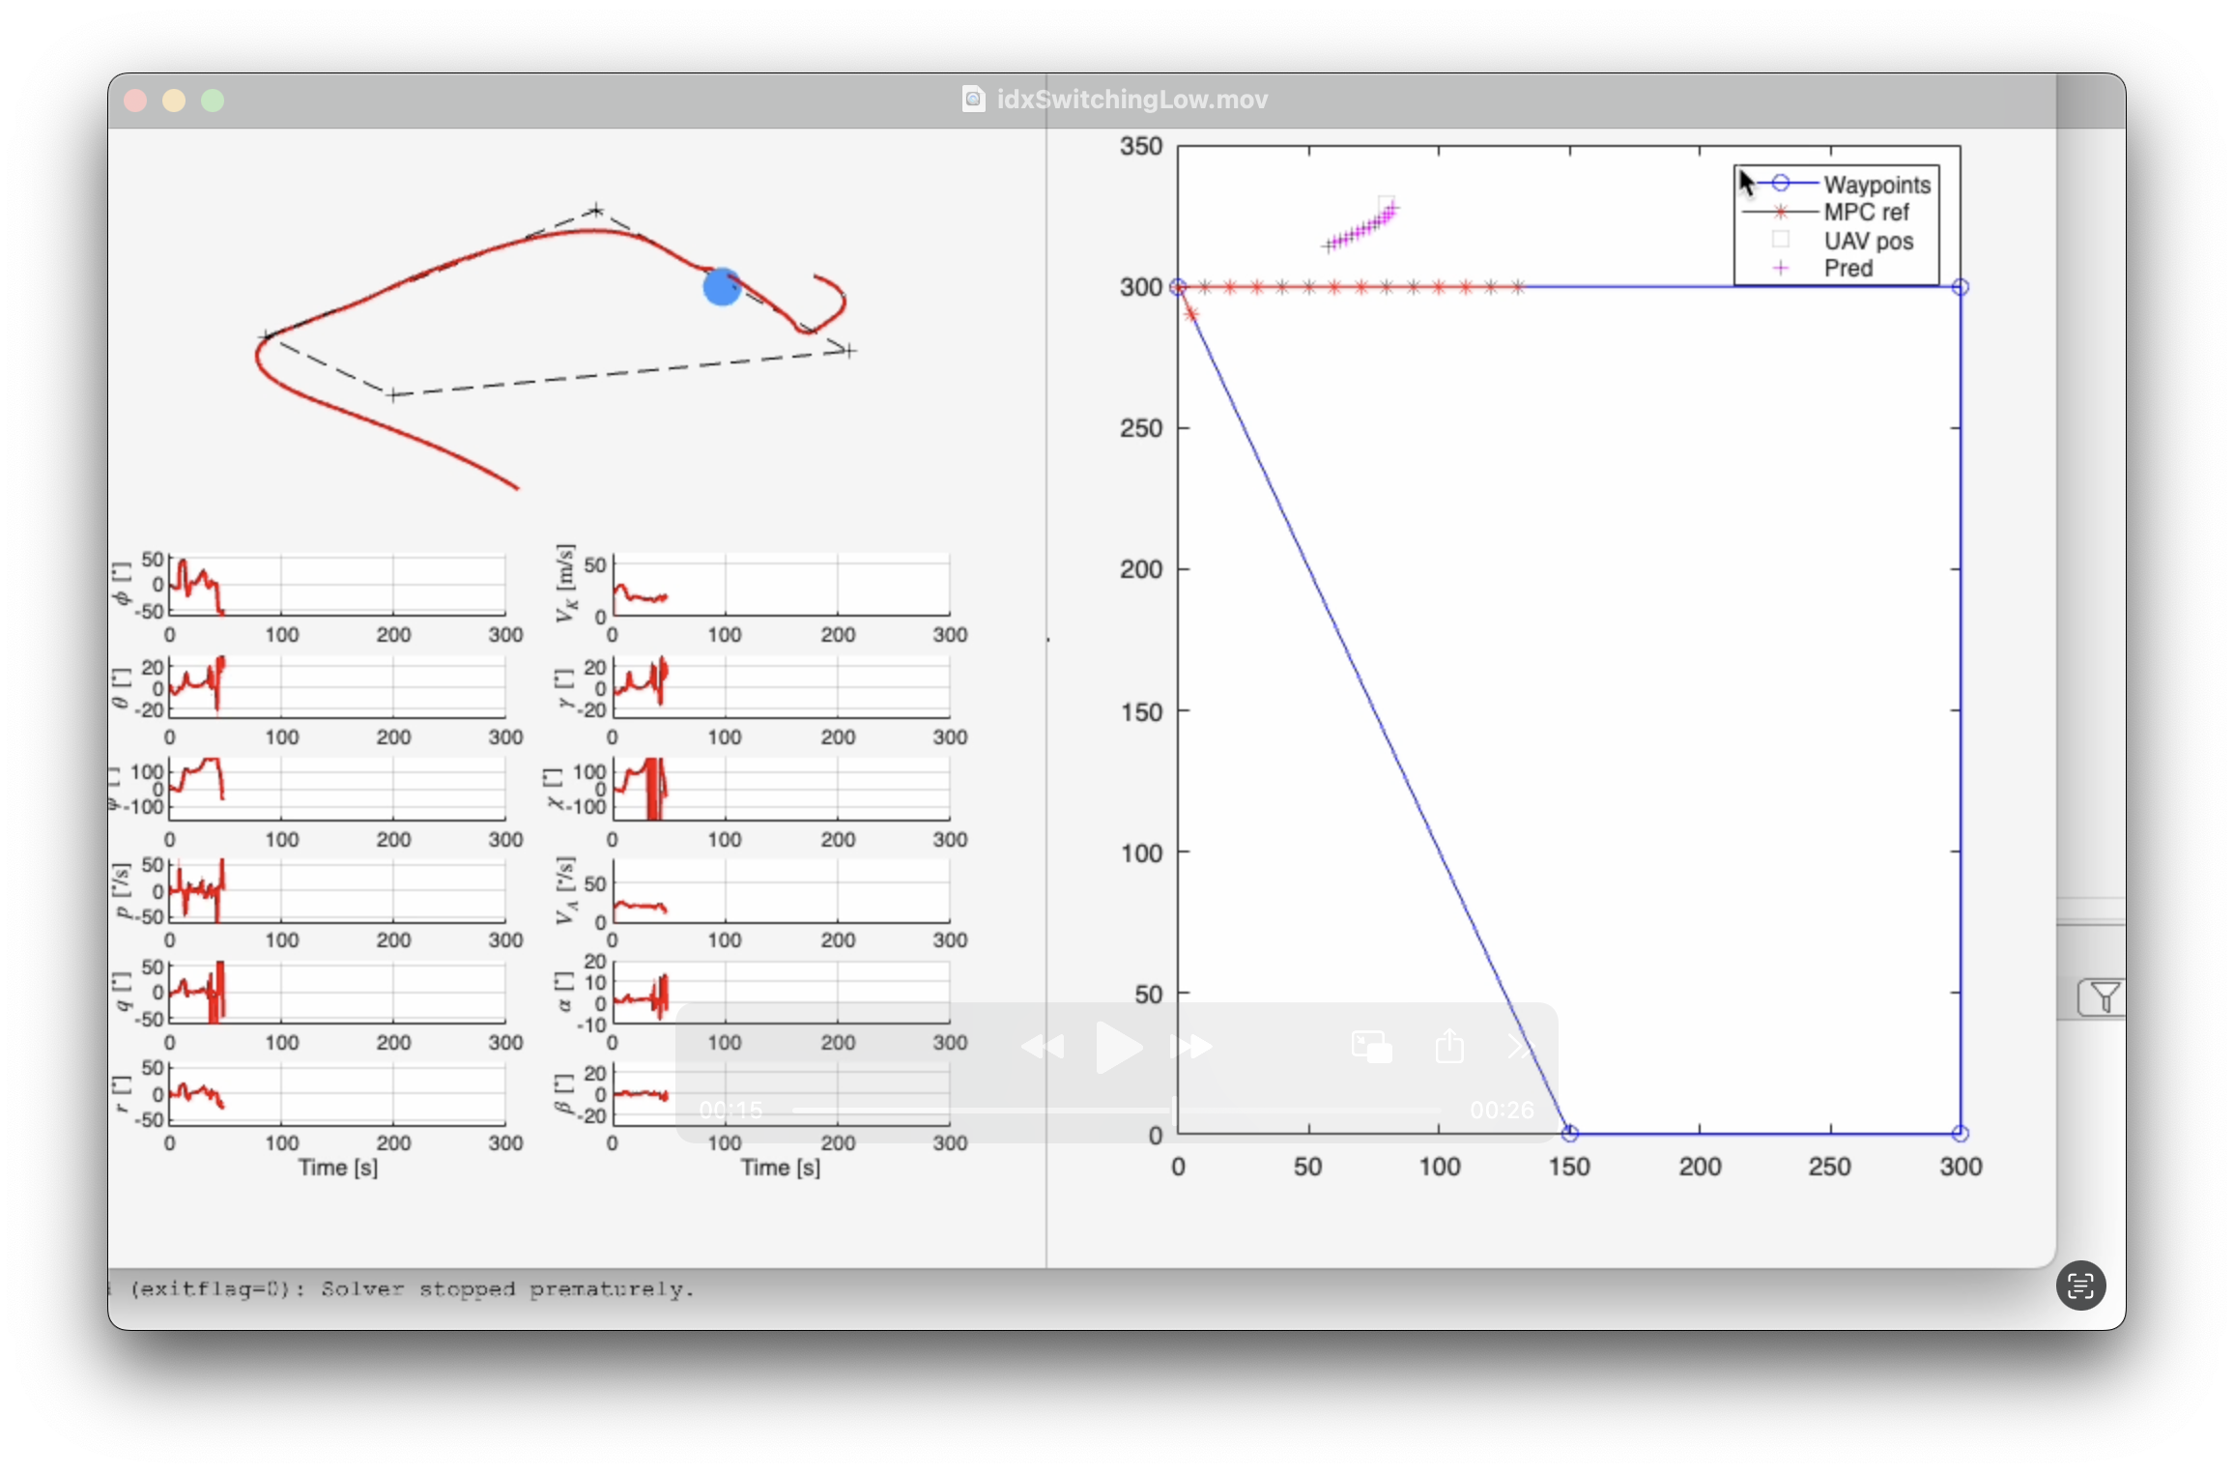
Index Switch Tolerance Low

Slide 32
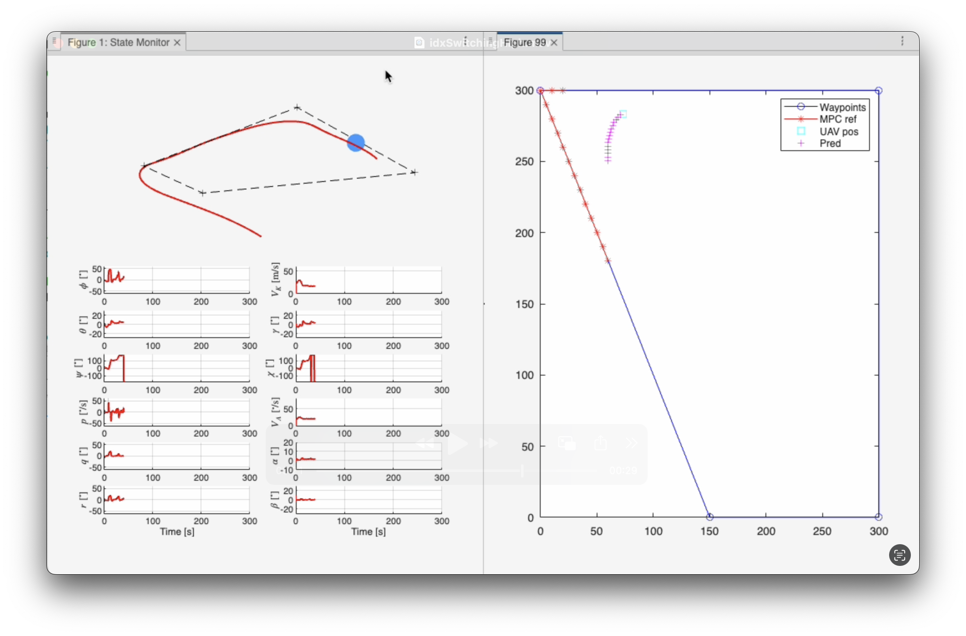
Index Switch Tolerance High

Slide 33
Parameter Analysis
Fine tuning prediction horizon = 15, reference points per segment = 30 , obstacle cost = 1000 & tolerance for index switching = 20m
Obstacle cost: High
Tolerance index switching:
Reference points per Segment:

Slide 34
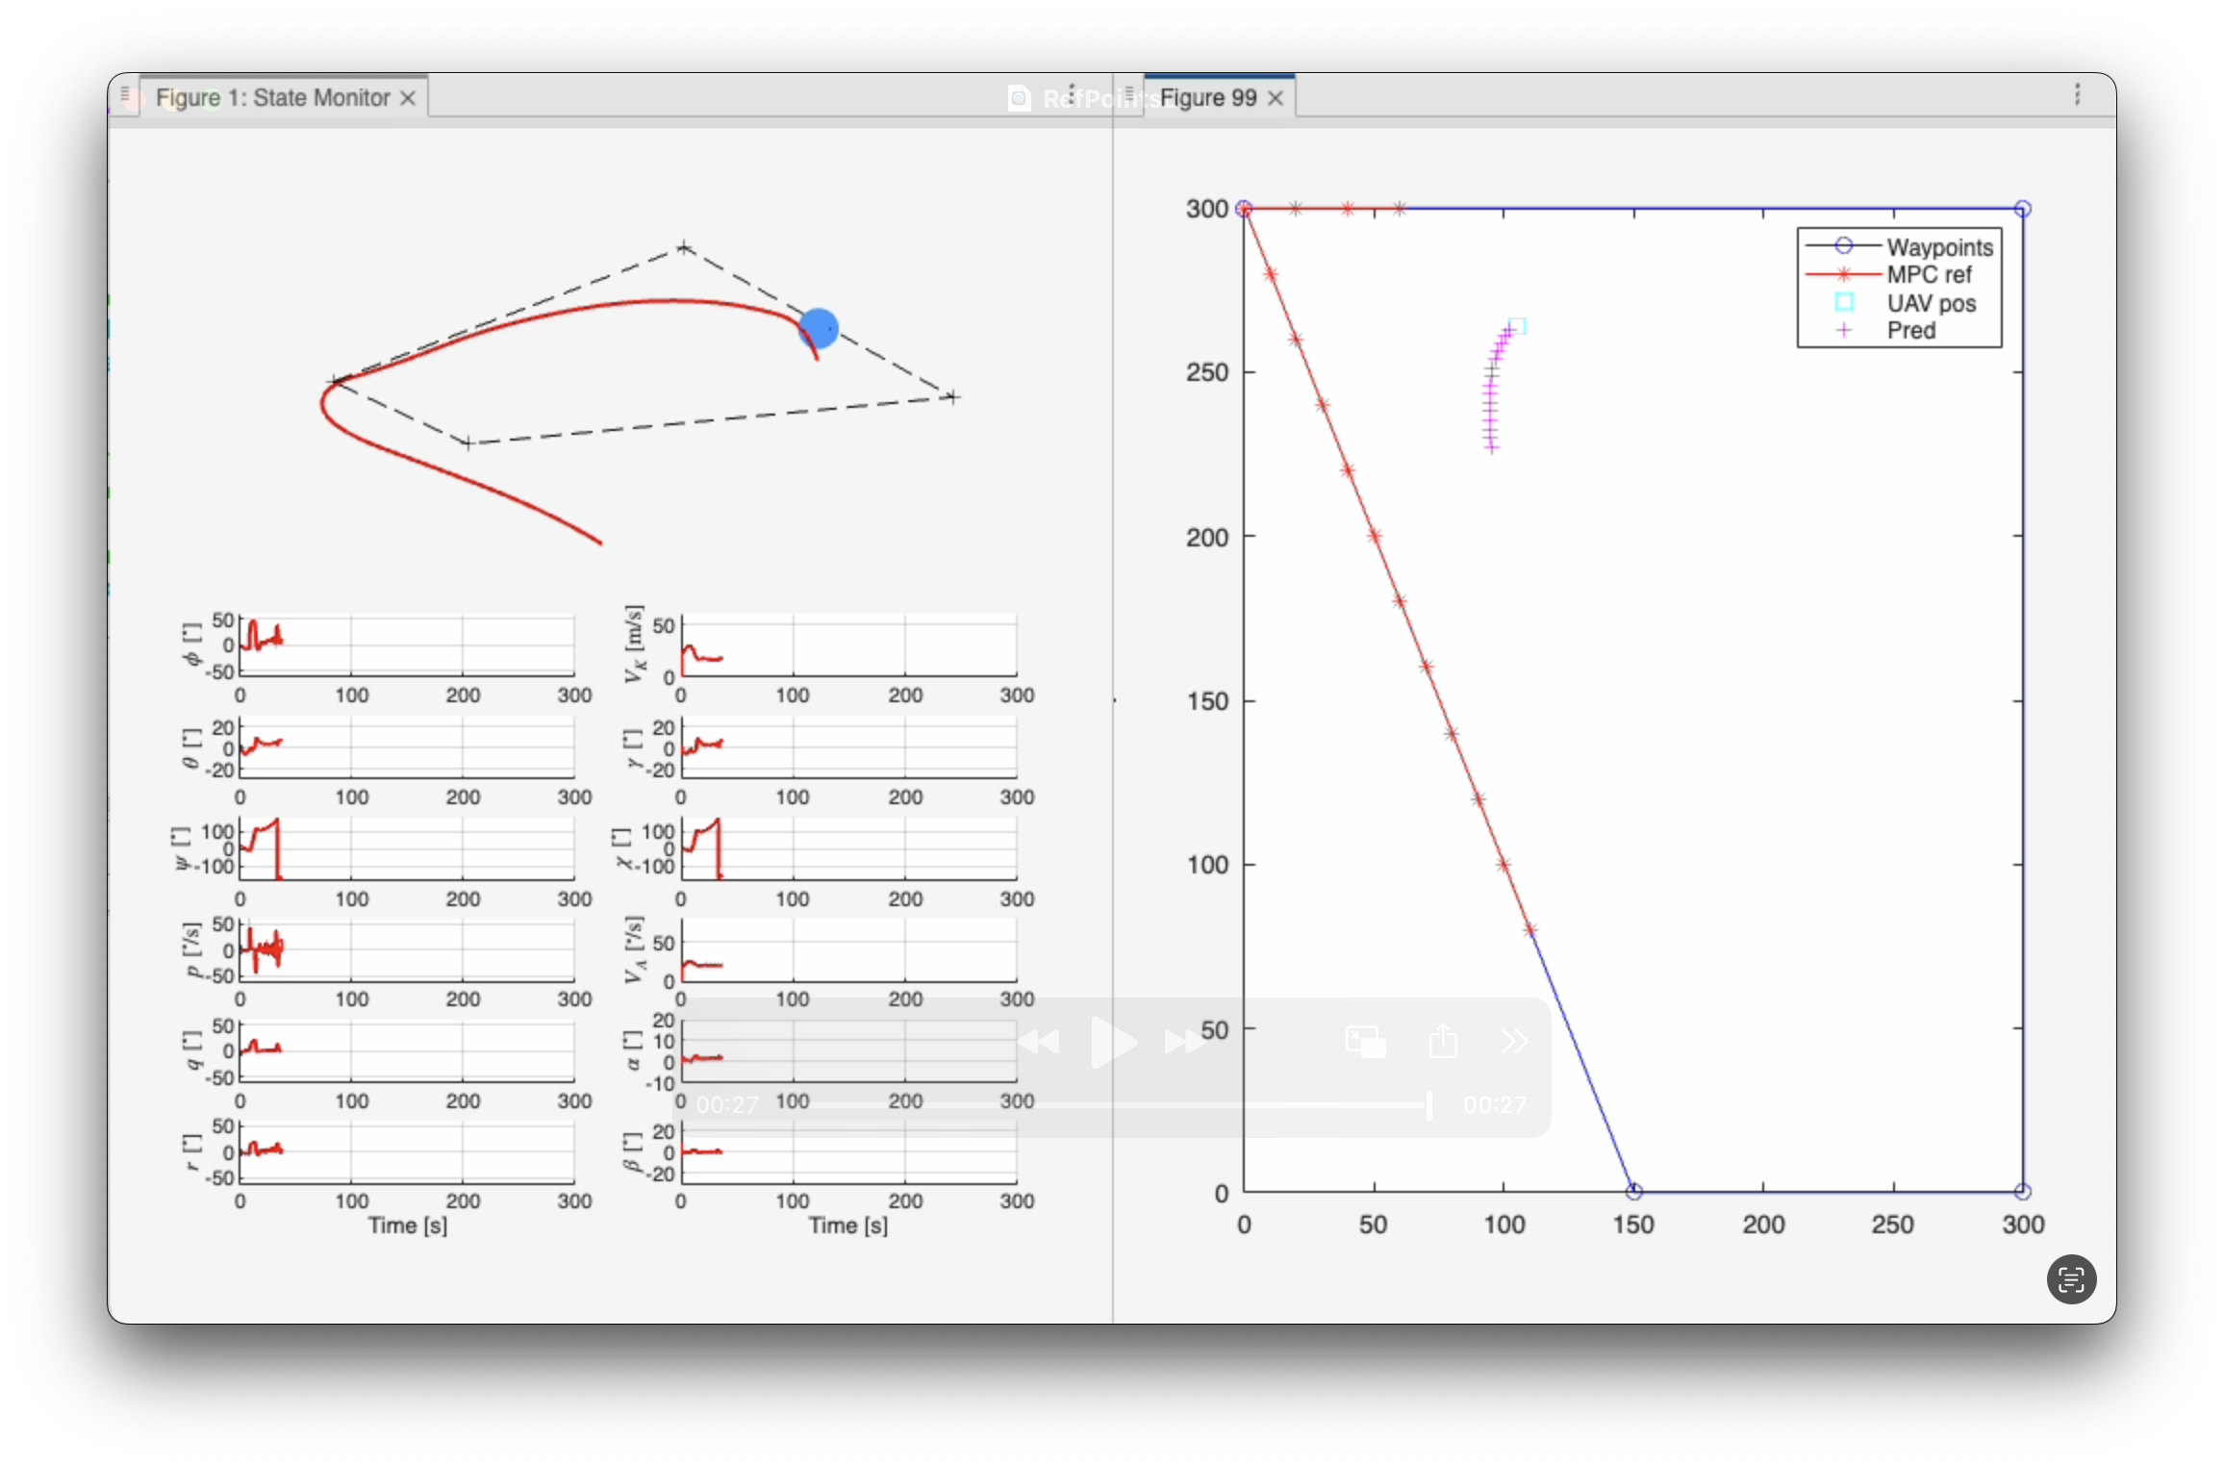
Reference Points Per Segment LOW

Slide 35

Reference Points Per Segment HIGh

Slide 36
Parameter Analysis
Fine tuning prediction horizon = 15, reference points per segment = 30 , obstacle cost = 1000 & tolerance for index switching = 20m
Obstacle cost: High
Tolerance index switching:
Reference points per Segment:
Prediction Horizon:

Slide 37
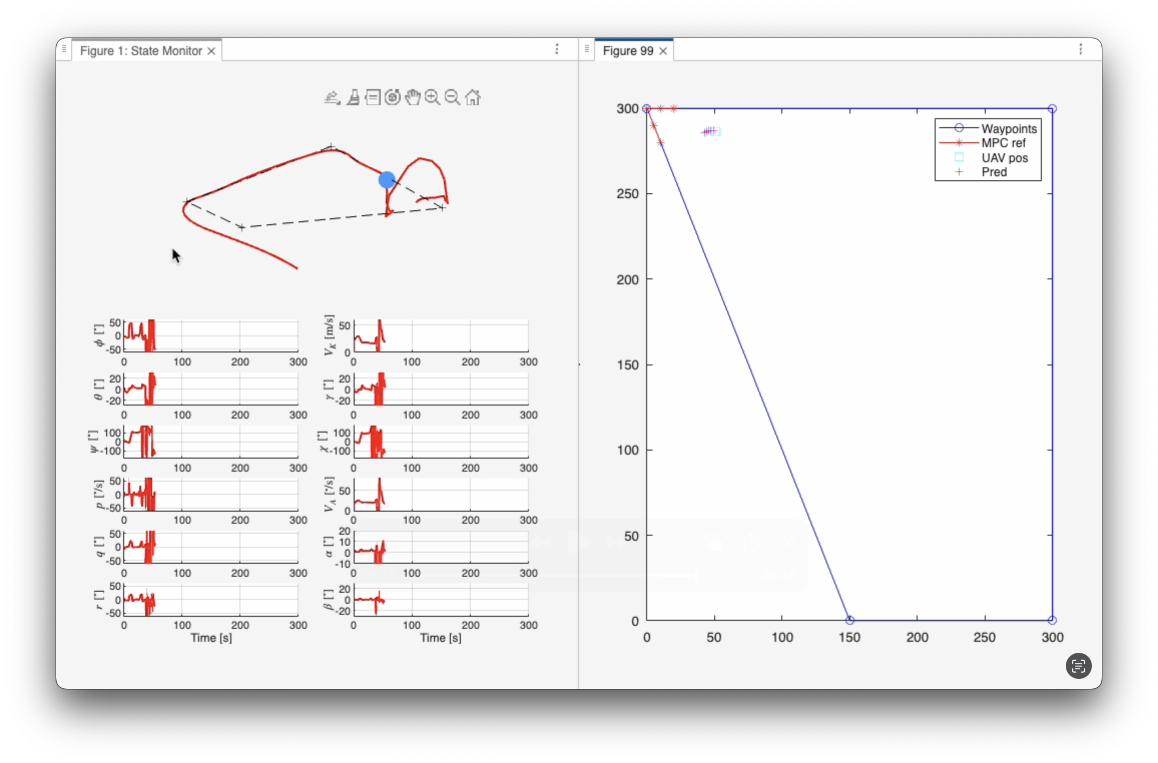
Prediction Horizon LOw

Slide 38
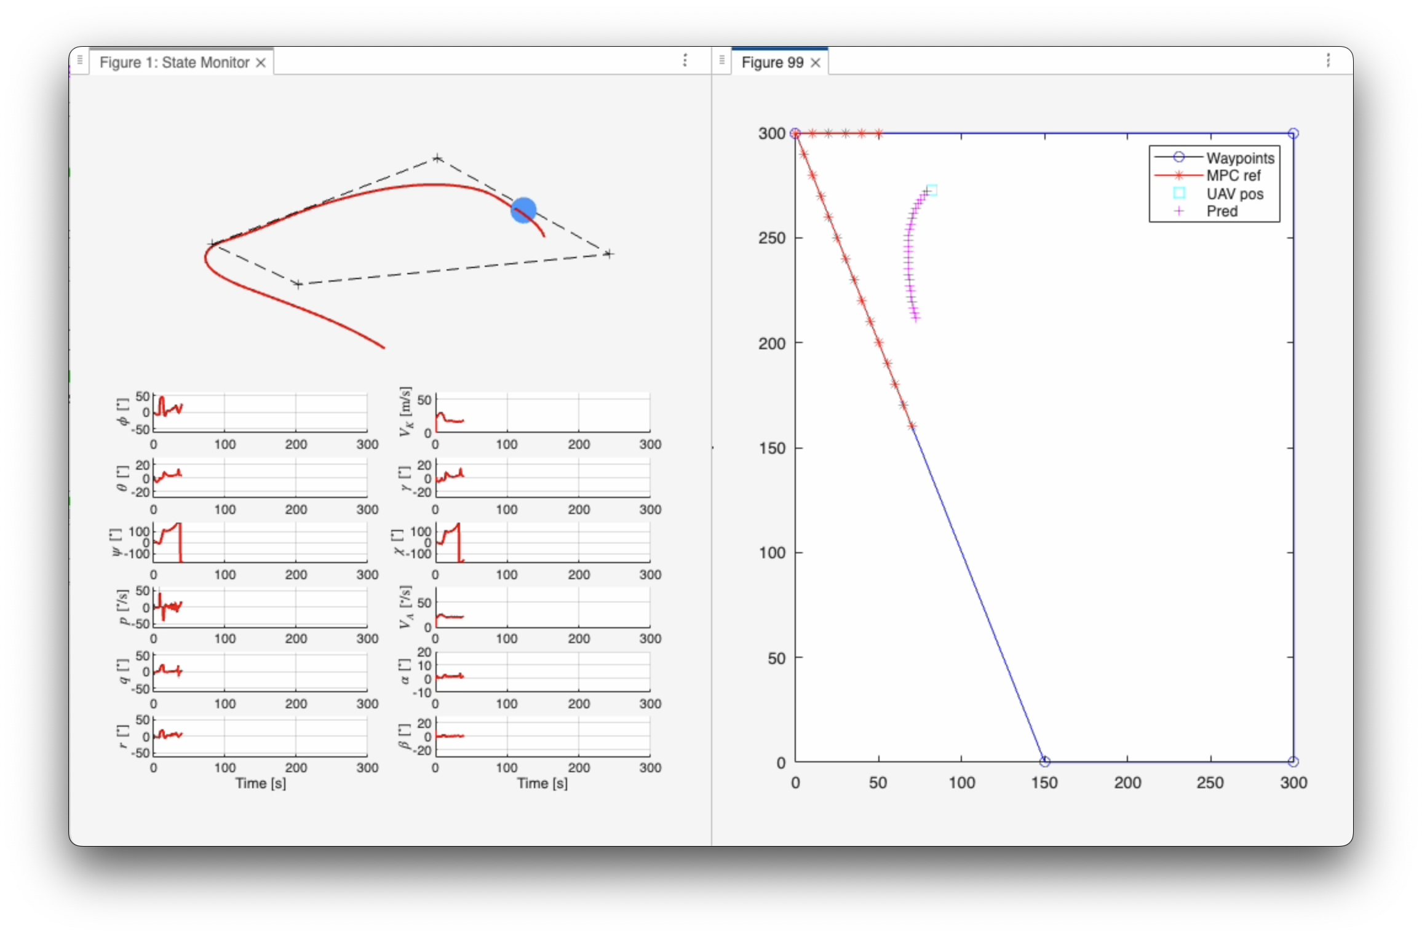
Prediction Horizon high

Slide 39
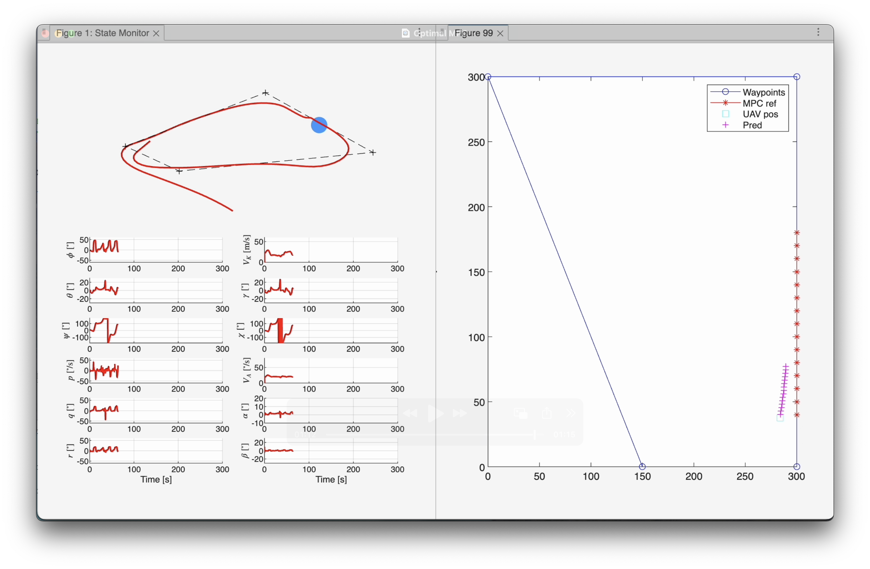
Result

Slide 40
Possible Next Steps
Optimize Reference Trajectory for wider range of Situation
More sophisticated Index Switch
Implement Hard Constraint without calculating drone dynamic again
Implement obstacles with different Geometry
Implement moving obstacles

Slide 41
THANK YOU
Matteo Vittorio Rossetto
Fabian Pelzer
Niels Liebchen
Tobias Görss

